Slide 1


Product Name Performance & Insights – Q3 2019
These materials were produced for InsideSherpa and to be used for educational and training purposes only.

Slide 2
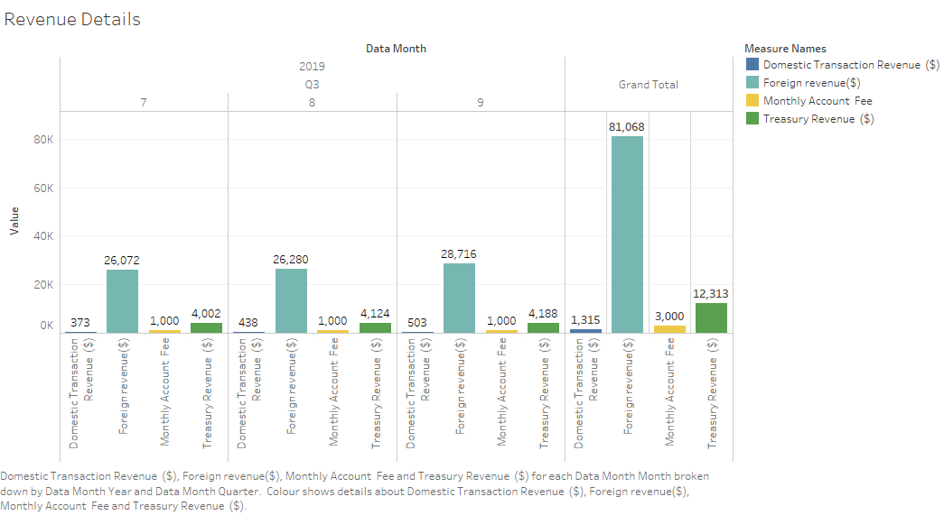
Revenue Growth and Drivers
Revenue from various sources for the month of July, August & September

Slide 3
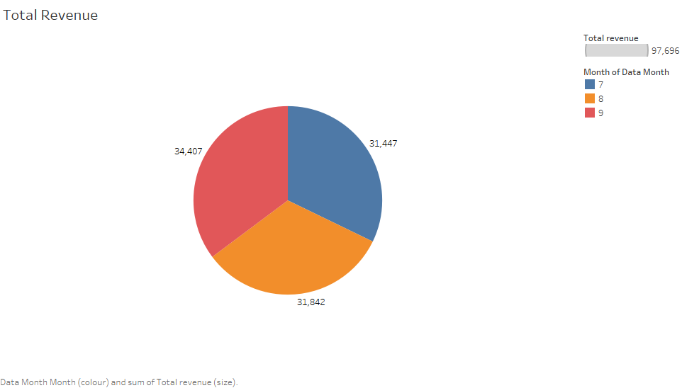
Revenue Growth and Drivers
Total Revenue for the month of July, August & September
September has recorded the highest revenue among all the months.

Slide 4
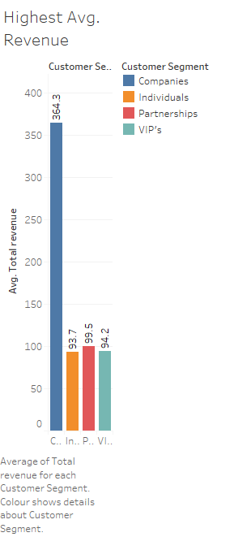
Revenue by Customer Segment
Segment Companies has the highest average revenue over the 3 month period.
It shows that organisations are happy with Citi’s corporate banking services.
Citi has to work more on individual customers satisfaction and providing
them with more customized banking services in order to increase
revenue out of this segment.

Slide 5
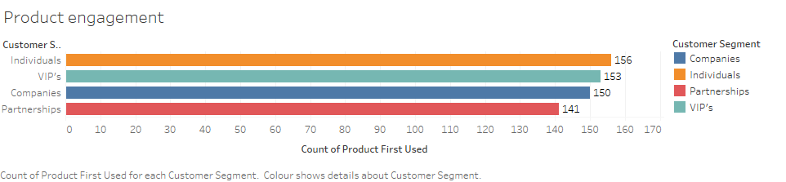
Segment Engagement
Product Engagement on the basis of highest no. product used by segments
Individuals has the highest product engagement in this category.

Slide 6
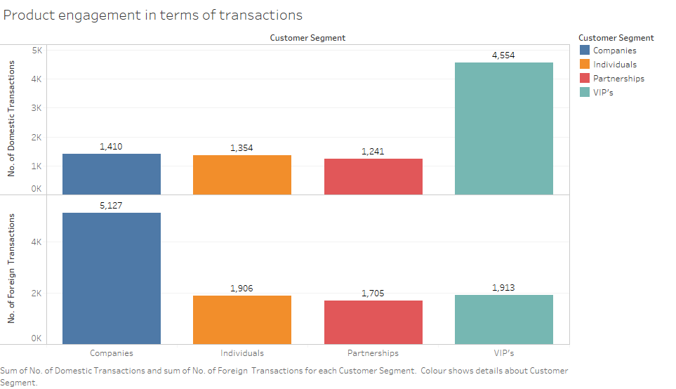
Segment Engagement

Slide 7
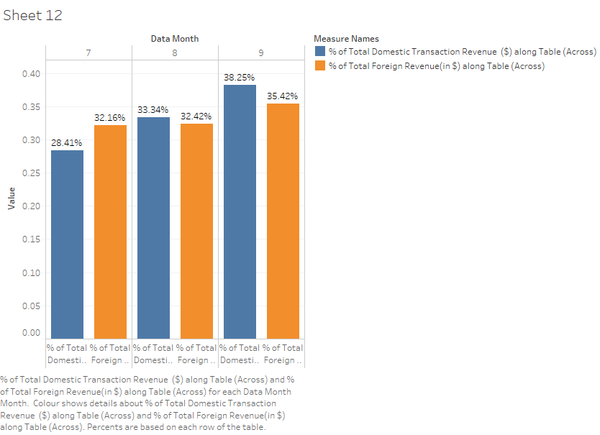
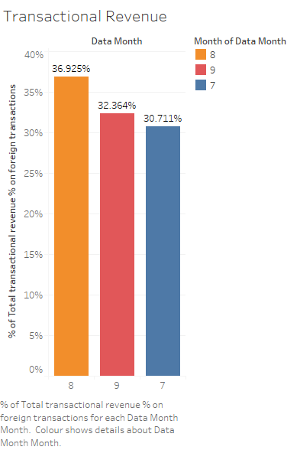
Transactional Revenue
Transactional revenue over the 3 months that has been earned from foreign transactions is shown below
This shows Citi Bank has a global presence and customers are satisfied with its transactional fees.

Slide 8
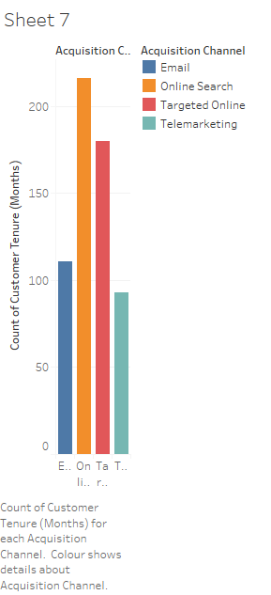
Acquisition Channels
Online search has been the most successful among all the acquisition channels.
This shows acceptance of Citi’s afford towards going digital.

